Slide 1
전자전기컴퓨터설계1
최종 프로젝트 중간발표
박지송 | 2017440052

Slide 2
목차
01
프로젝트 목적
02
프로젝트 내용
03
프로젝트 회로도
프로젝트 결과
04

Slide 3
프로젝트 목적
제작
설계
측정
Electrical
engineer
해석
테스트

Slide 4
프로젝트 내용
Square Wave Oscillator Using 555 TImer
Analog Computer(2)
Step 1
Step 2
Step 3
Analog Computer(1)

Slide 5
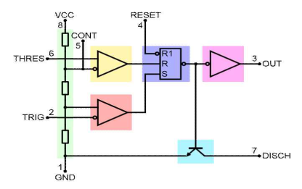
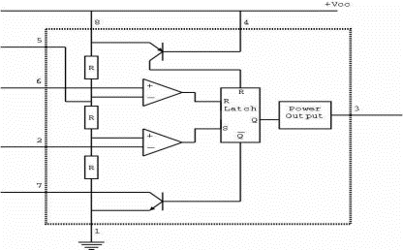
Square Wave Oscillator Using 555 Timer
| Blockdiagram of 555 timer |

Slide 6
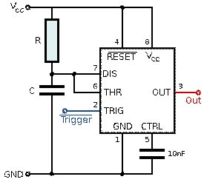
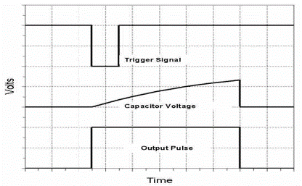
Square Wave Oscillator Using 555 Timer
| Monostable mode |

Slide 7
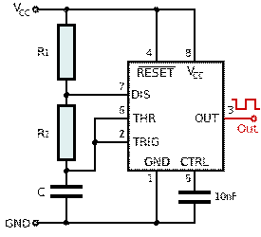
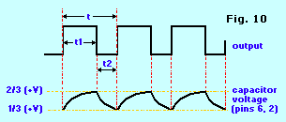
Square Wave Oscillator Using 555 Timer
| Astable mode |

Slide 8


Square Wave Oscillator Using 555 Timer

Slide 9
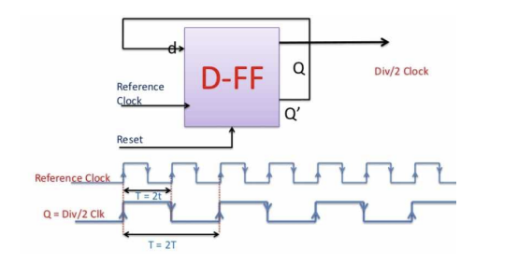
Clock Frequency Divider
| Divider by 2 using D-flip/flop(7474) |

Slide 10
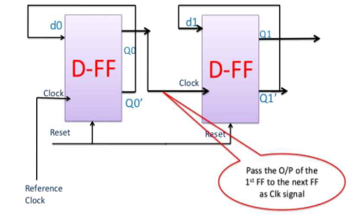
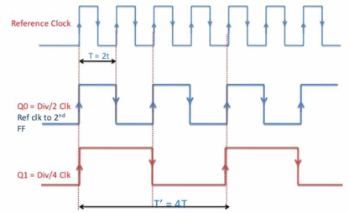
Clock Frequency Divider
| Divider by 4 using D-flip/flop(7474) |

Slide 11
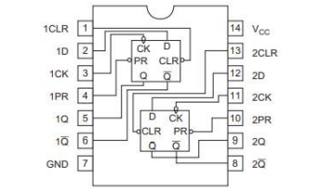
Clock Frequency Divider
| 7474 D-type F/F |

Slide 12
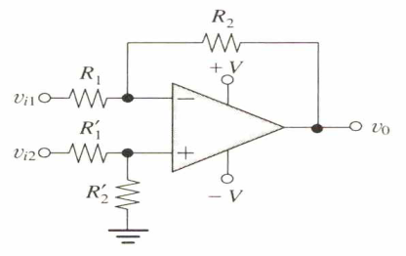

Analog computer
| Differential Amplifier |

Slide 13
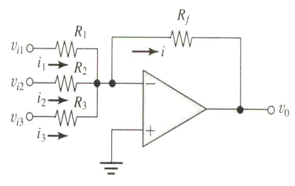
Analog computer
| Inverting summing amplifier |

Slide 14
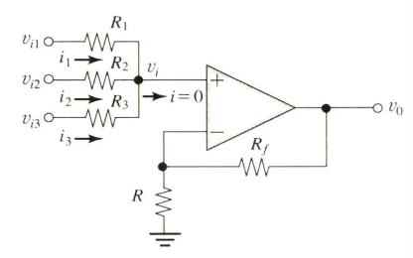

Analog computer
| Non - Inverting summing amplifier |

Slide 15
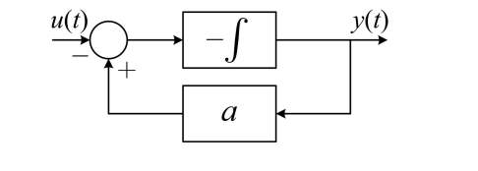
Analog computer
| Analog computer for first-order linear differential equation|

Slide 16
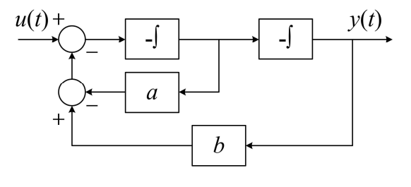
Analog computer
| Analog computer for second-order linear differential equation|

Slide 17
Analog computer
| Non - Inverting summing amplifier |

Slide 18
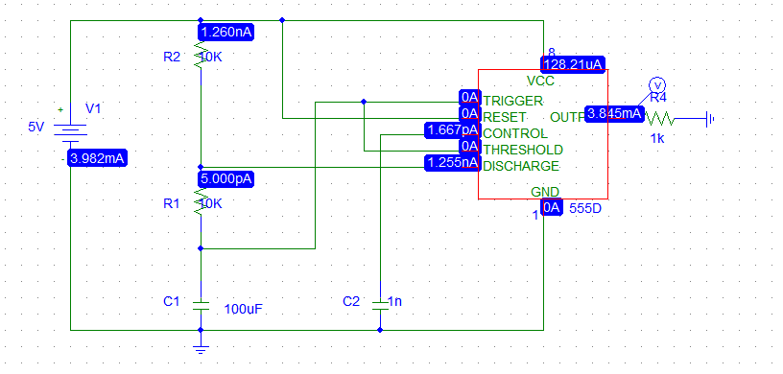
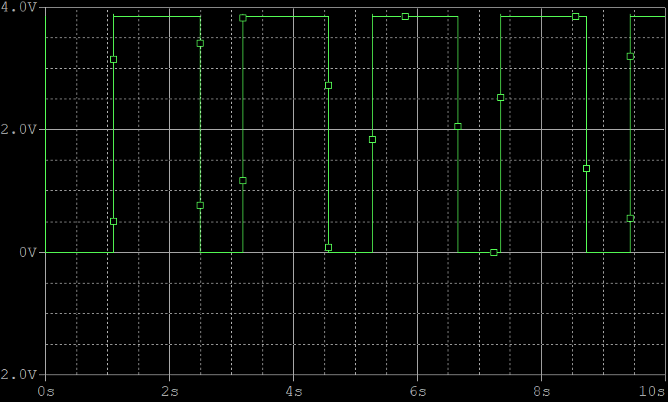
555Timer 회로도
| Square wave oscillator |

Slide 19
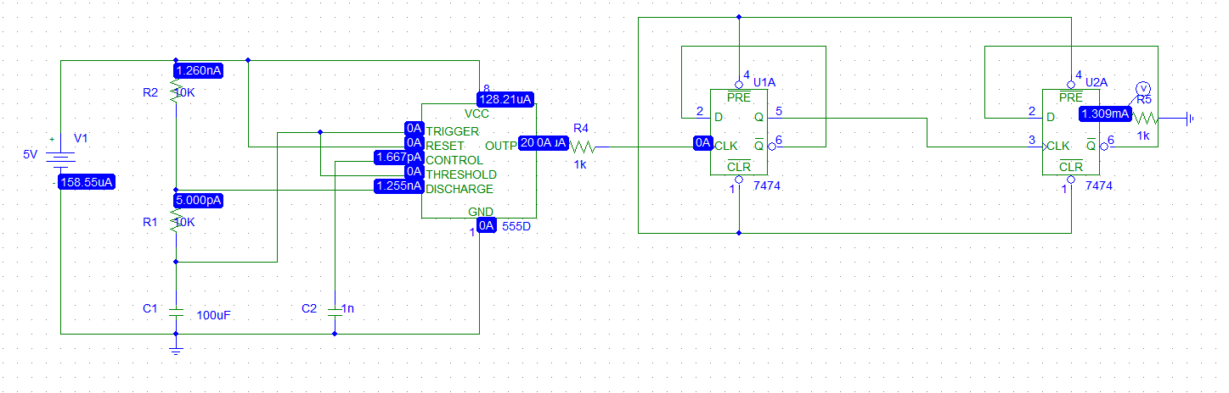
555timer&D-flip/flop 회로도
| Clock frequency divider-4 |

Slide 20
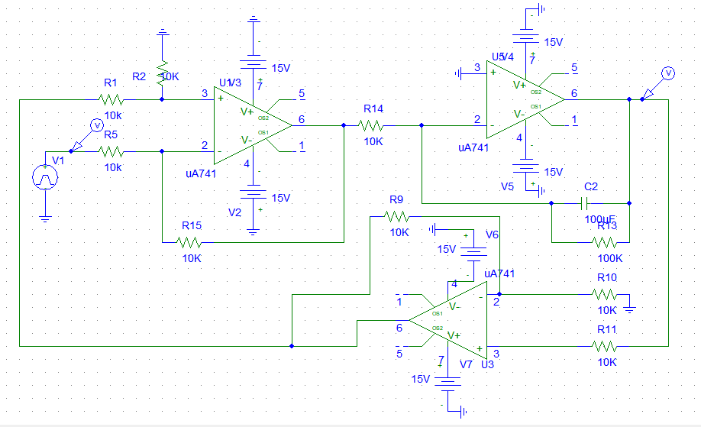
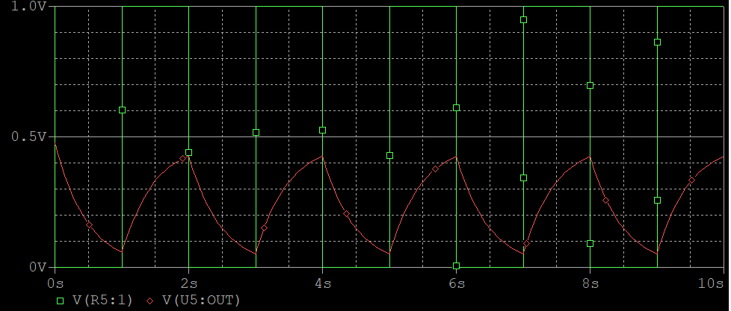
Analog computer(1) 회로도
|Analog computer for first-order linear differential equation |

Slide 21
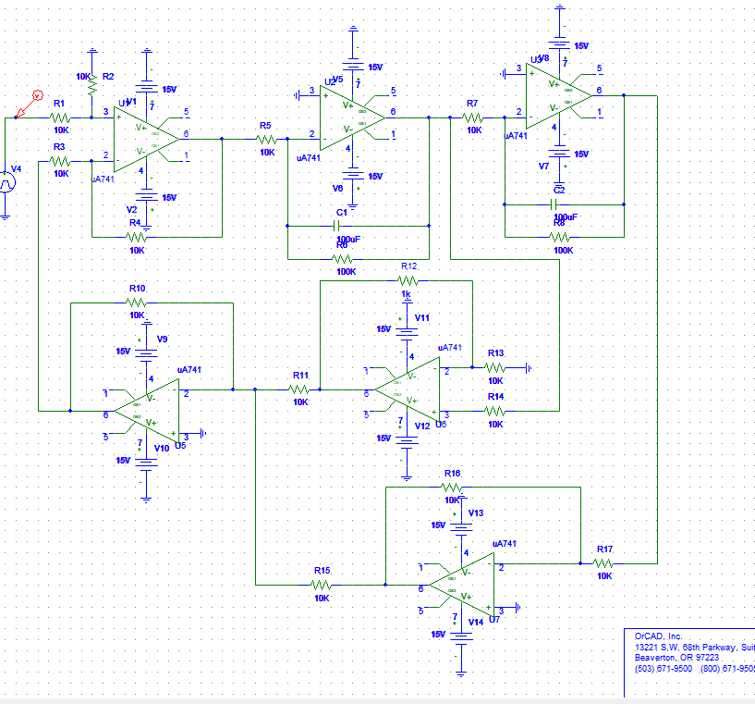
Analog computer(2)회로도
|Analog computer for second-order linear differential equation(overdamped) |

Slide 22
참고문헌
- 전자전기컴퓨터설계실험1 교안

